Slide 1
Ansible

Slide 2
Define
Describe
Note:
You can refer the attached pdf to write objectives
Notes:
Action verbs: abstract, acquire, adjust, agree, analyze, apply, appraise, argue, assess, avoid, breakdown, build, calculate, carry out, catalog, clarify, classify, combine, compare, compute, conclude, construct, contrast, convert, cooperate, create, criticize, defend, define, demonstrate, derive, describe, design, detect, determine, differentiate, discover, discriminate, discuss, dissect, distinguish, employ, estimate, evaluate, examine, explain, explore, formulate, generalize, help, identify, illustrate, implement, indicate, inspect, instruct, integrate, interpret, investigate, join, judge, justify, label, list, master, measure, move, name, observe, offer, operate, order, organize, participate, perform, plan, praise, predict, prepare, produce, propose, rank, recall, recognize, relate, repair, represent, reproduce, research, restate, resolve, select, sequence, solve, specify, state, summarize, support, systematize, taste, test, theorize, transform, translate, use, utilize, verify, weigh, write, etc.

Slide 3
Note:
If you want to update this slide, you can modify it in the master slide.

Slide 4
Course Agenda
No | Module Name | Duration (hours)
1
2
3
4
5
6
7

Slide 5
Course Overview
<If required, add additional information about the course such as course overview, prerequisites etc. >
Note:
When you have multiple modules in a course, group the slides 1 to 5 as a separate PPT and rest of the slides as separate modules. Ensure that the last module has the Course Summary slide.
When you have only one module in a course, delete the slides that are specific to course (Slide 1, 2, 4, 5 and Course Summary).

Slide 6
Module 1: Introduction and installation of Ansible

Slide 7
Identify
Define

Slide 8
Topic List
Ansible
Playbooks Basics
Need & Limitations of Ansible
Architecture
Roles of Host and Nodes
Install Ansible

Slide 9
Topic List
Ansible
Topic 2
Topic 3
Topic 4
Topic 5
Topic 6
Topic 7

Slide 10
Ansible
Ansible: Open source configuration management and orchestration utility
Automates and standardizes configuration of remote hosts and virtual machines
Coordinates launch and shutdown of multitiered applications
Performs rolling updates of multiple systems with zero downtime
Originally written by Michael DeHaan
Creator of Cobbler provisioning application
System administrators find it simple to use
Developers can easily learn
Built on Python
Supported by DevOps tools such as Vagrant and Jenkins

Slide 11
Topic List
Topic 1
Playbooks & Modules
Topic 3
Topic 4
Topic 5
Topic 6
Topic 7

Slide 12
Playbooks & Modules
System administrators create playbooks that call modules to perform work
Replaces custom, individualized scripts
Playbooks: YAML files executed in top-down, sequential fashion
Define modules applied to remote systems and arguments passed to them
Agentless architecture
Work pushed to remote hosts when Ansible executes
Comes with hundreds of core modules that:
Perform system administration work
Make Ansible immediately useful

Slide 13
Topic List
Topic 1
Topic 2
Architecture
Topic 4
Topic 5
Topic 6
Topic 7

Slide 14
Architecture
Two types of machines in Ansible architecture: control node and managed hosts
Ansible software installed and components maintained on control node
Managed hosts listed in host inventory
Text file on control node with managed host names or IP addresses
System administrators log in to control node and launch Ansible
Specify playbook
Specify target host to manage: single system, group of hosts, or wild card
SSH used as network transport to communicate with managed hosts
Modules referenced in playbook copied to managed hosts
Modules execute in order with arguments specified in playbook
Core modules perform most system administration tasks
Users can write custom modules

Slide 15
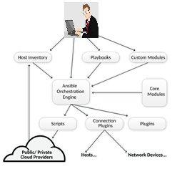
Ansible Architecture
Ansible Components
Ansbile Configuration: Defines how Ansible behaves. Settings include:
Remote user for command execution
Passwords for executing remote commands.
To override default values, use environment variables or values defined in configuration files.
Host Inventory:
Defines configuration groups to which hosts belong
Defines how Ansible communicates with managed host
Defines host and group variable values
Core Modules:
Programs copied to managed hosts to perform work for Ansible
Over 400 core modules built in
Custom Modules:
Extend functionality
Typically written in Python
Alternative: Any interpreted programming language
Add custom modules to Ansible library

Slide 16
Ansible Architecture
Ansible Components
Playbooks:
Files written in YAML syntax
Define modules, with arguments, to apply to managed nodes
Declare tasks that need to be performed.
Connection plug-ins:
Enable communication with remote hosts and cloud
Include native SSH (default), paramiko SSH, and local
Paramiko: Python implementation of OpenSSH for Red Hat Enterprise Linux 6
Provides ControlPersist performance setting required
Plug-ins
Extend Ansible’s functionality
Examples: Email notifications and logging
Custom Modules:
Extend functionality
Typically written in Python, Alternative: Any interpreted programming language
Add custom modules to Ansible library

Slide 17
Topic List
Topic 1
Topic 2
Topic 3
Need of Ansible and limitations
Topic 5
Topic 6
Topic 7

Slide 18
Ansible Need & Limitations
Need
Ansible strength: Simplifies software configuration of servers
When Ansible accesses managed hosts, it can discover version of Red Hat Enterprise Linux running on remote server
Ansible determines if host is properly entitled by comparing installed applications and applied software subscriptions
Ansible playbooks can consistently build development, test, and production servers
Kickstart can get bare-metal servers running
Ansible builds them further
Provision servers to corporate baseline standard or specific role within datacenter
Zero Downtime Rollover Upgrades
Ansible lets you update applications in parallel. Example: Develop playbook to execute the stop, remove server, deploy, update, start, confirm services are available, add server back to load balancing, restart on application servers:
Jboss: Ansible can discover JBoss versions and reconcile subscriptions. All JBoss configurations are centrally stored on Ansible control node
Ansible can manage software development life cycle for applications deployed into OpenShift
Red Hat Satellite: Ansible can supplement functionality provided by Red Hat Satellite like deploy satellite agents to existing servers in datacenter etc

Slide 19
Ansible Need & Limitations
Limitations
Cannot audit changes made by other users on system
Example: Cannot determine who made change to a file
Does not perform initial minimal installation of system
Start with minimal installation via Kickstart or base cloud starter image
Use Ansible to add packages and for configuration
Does not monitor configuration drift
Can remediate it
Does not track changes made to files on system
Does not track which user or process made changes
To track changes, use version control system or Linux Auditing System

Slide 20
Topic List
Topic 1
Topic 2
Topic 3
Topic 4
Roles of Hosts and Nodes
Topic 6
Topic 7

Slide 21
Ansible
Control Node Role
System administrators log in and initiate Ansible operations from control node
Ansible software installed and configuration files maintained on control node
Other names for control node: Ansible host and control machine
Control Node Requirements
Must have Python 2.6 or 2.7 installed
Includes Linux, OS X, any BSD-based UNIX system
Windows not currently supported for control node
On Red Hat Enterprise Linux 6 or 7, ansible package and dependencies must be installed
Default connection method used by Ansible
If OpenSSH on control node supports ControlPersist option
Ansible supports passwords for SSH authentication
Most common practice: Use SSH user keys to access managed hosts

Slide 22
Ansible
Managed Host Role
Ansible does the following on managed host systems:
Logs in
Installs modules
Executes remote commands for configuration
Other names for managed host: managed node and remote node
Managed Host Requriements
SSH must be installed and configured : Allows incoming connections and communication with managed hosts
Python 2.4 or later
Lets you use Ansible to manage Red Hat Enterprise Linux 5, 6, and 7 hosts
python-simplejson package must be installed on Red Hat Enterprise Linux 5 managed hosts
Not required on Red Hat Enterprise Linux 6 and 7 managed hosts. Python 2.5 and newer versions provide functionality by default.
Modules can have their own unique software requirements. Playbooks must be written so that prerequisite software is installed before calling a module that uses it.

Slide 23
Topic List
Topic 1
Topic 2
Topic 3
Topic 4
Topic 5
Install Ansible
Topic 7

Slide 24
Installation
WHERE TO GET & HOW TO INSTALL
OS packages ( recommended)
EPEL
APT
Also available from
Pypi
Sources ( via GITHUB)
Installing Ansible
* Enable ‘Extras’ and ‘Optional’ yum repos
* Install Ansible
Command: yum –y install ansible
Refer : docs.ansible.com/ansible/intro_installation.html

Slide 25
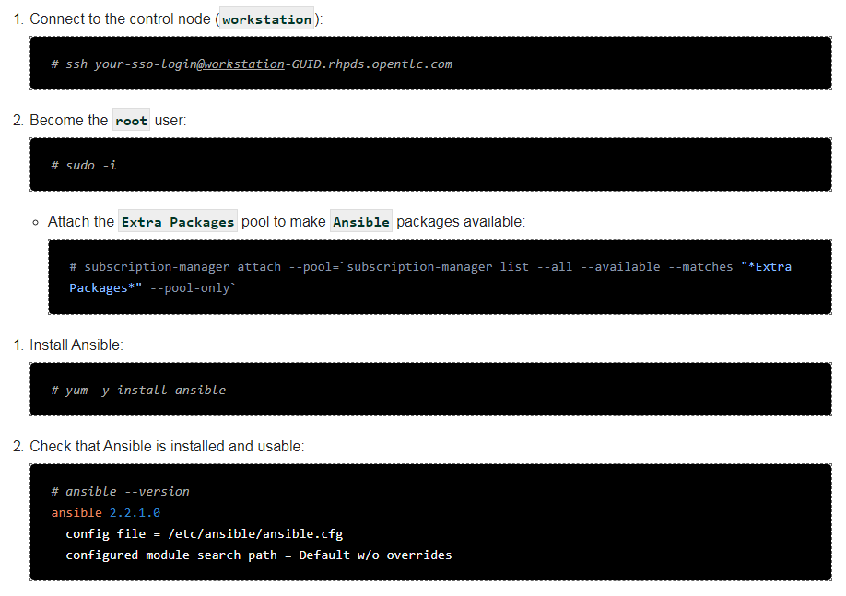
Ansible ( TO BE CHANGED)

Slide 26
Thank You

